Slide 1
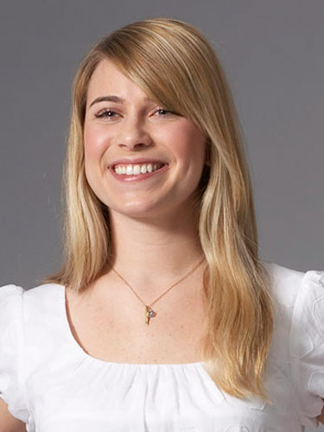
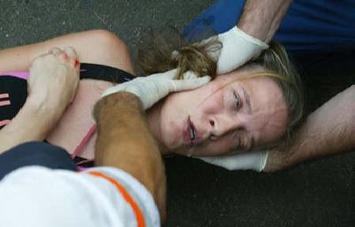

Slide 2
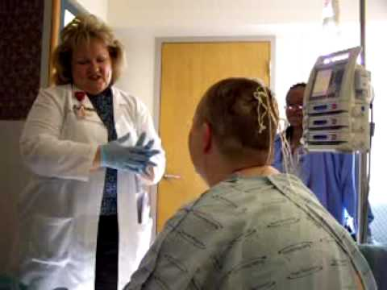
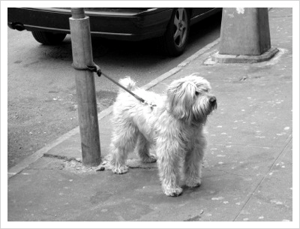

Slide 3
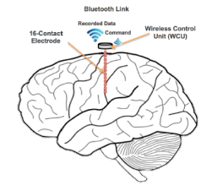

Slide 4
WIRELESS NEURAL RECORDER
Untethering 70 Million Epilepsy Patients
Stephen Xia Tingkai Liu Julian Gao Xin Huang

Slide 5
Affected Patients
1% of Population | 10 - 25 Million Operations/ Year
5 - 6 Days per Operation

Slide 6
Customers – EEG Service Providers
Hospitals | Clinics | Research Institutes
> 4500 | > 5500 | 150

Slide 7
Total Market Value
Customers * Machines * Unit Price
$ 300 Million

Slide 8
Customer Needs
Safety (FDA, HIPAA, WHO MDR)
Real-Time, Accurate & Reliable Data
Convenience, Mobility & Low Power

Slide 9
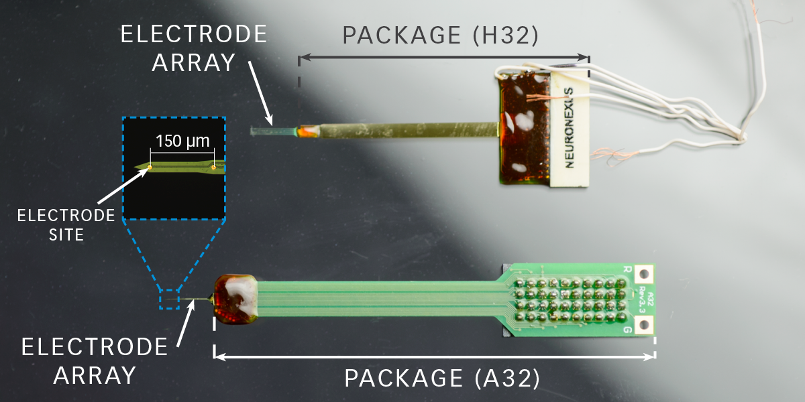
NEuronexus
Wired Connection
Large form factor

Slide 10
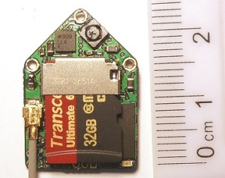
DEUTERON Wireless Neural Logger
Animal only application
Large size
Not real-time

Slide 11
Design Specifications
Customer Needs | Design Specifications
Safe | Skin Temperature Change: Feedback Current: | < 2℃ 0 μA
Real-Time, Accurate, Comprehensive | Transmission Rate: Sampling Rate: Sampling Precision: | 128 kB/s 1 kHz 16-channel, 8-bit
Portable, Convenient, and Low Power | Battery Life: Module Size: | > 24 hours 4x4 mm top area

Slide 12

System Diagram

Slide 13

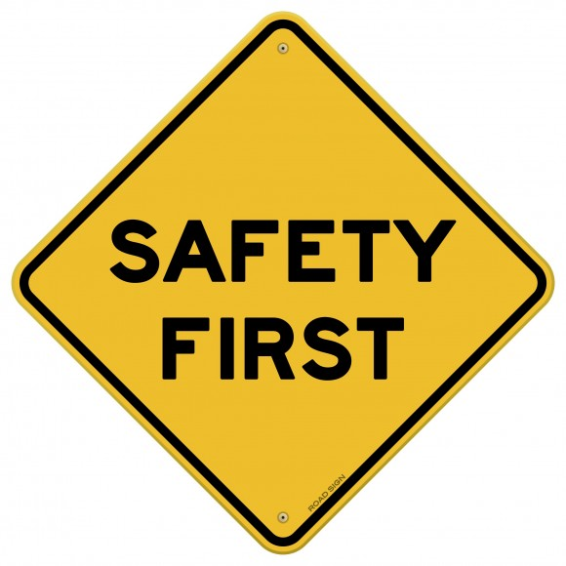
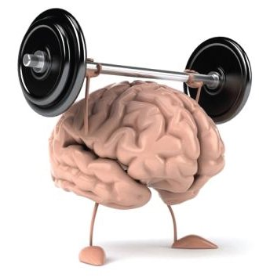
Challenges

Slide 14
Wireless Options
Wifi
High Range
Bluetooth
Low Energy
High Range
Medium Bandwidth
Near Field
Communication
Low Range
RF4CE
ZigBee
High Bandwidth
High Data Transfer
Medium Power Consumption
Medium Data Transfer
Low Power Consumption
Low Bandwidth
Low Data Transfer
Low Power Consumption
Medium Range
Low Bandwidth
Medium Data Transfer
Low Power Consumption
High Range
Medium Bandwith
High Data Transfer
High Power Consumption
5 Potential Options for Wireless Data Transfer

Slide 15
Wireless Options
Wifi
High Range
Bluetooth
Low Energy
High Range
Medium Bandwidth
Near Field
Communication
Low Range
RF4CE
ZigBee
High Bandwidth
High Data Transfer
Medium Power Consumption
Medium Data Transfer
Low Power Consumption
Low Bandwidth
Low Data Transfer
Low Power Consumption
Medium Range
Low Bandwidth
Medium Data Transfer
Low Power Consumption
High Range
Medium Bandwith
High Data Transfer
High Power Consumption
5 Potential Options for Wireless Data Transfer

Slide 16
Bluetooth Low Energy
Will use TI CC2640 BLE 4.2 as our data transmission source with optimal tradeoff between performance and power
Industry-leading privacy. Keeps Bluetooth Smart devices from being tracked.
Highly secure. Features industry-standard encryption ensuring confidential data stays that way.
More power efficient. Introduces refinements that make Bluetooth Smart even more power-stingy.

Slide 17
Power Options
Powering the electrode is a huge challenge due to size and longevity constraints
2 Options
High density replaceable medical device batteries
Inductive charging via brain’s electrical impulses

Slide 18
Power Options
Powering the electrode is a huge challenge due to size and longevity constraints
2 Options
High density replaceable medical device batteries
Inductive charging via brain’s electrical impulses

Slide 19
3 Stage Testing
Stage 1
Single electrode circuit prototype
Test BLE technology with generated signals
Debug circuit and improve design
Stage 2
Multiple electrodes prototype
Test multi-system communications
Test battery performance in simulated brain condition
Stage 3
Full 16 electrode system
Mobile data recording device
Animal testing in real world environment

Slide 20
Wireless Neural Recorder
Improve Epilepsy patients’ quality of life
Untether them from the limitation of existing technology
Improve monitoring with more data for better procedural
Applications not only limited to epilepsy
Sleep diagnosis
Diagnosis diseases of the brain
Brain stimulation

Slide 21
